Slide 1
BORDER MOULDING
Dr. Shivsagar Tewary
DEPT OF PROSTHODONTICS
School of Dental Sciences, KIMSDU, Karad

Slide 2
Learning objectives
At the end of the lecture, the student should know the following points
1. Definition of border moulding
2. Techniques
3. Materials required for fabrication
4. Tests for retention

Slide 3
CONTENTS
Introduction
Definition of border molding
Materials used for border molding
Different techniques used for border molding
Review of literature
Conclusion
References

Slide 4
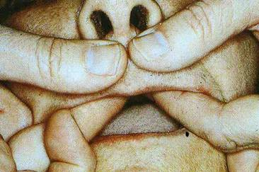
Border molding is important step in complete denture impression procedure final impressions.

Slide 5
SYNONYMS
MUSCLE TRIMMING
PERIPHERAL TRACING
Notes:
This term was used because of trimming and shaping effect of muscles of the border seal area.

Slide 6
DEFINITION
1 .The shaping of the border areas of an impression by functional or manual manipulation of the tissue adjacent to the border to duplicate the contour and the size of the vestibule.
2. Determining the extension of a prosthesis by using tissue function or manual manipulation of the tissues to shape the border areas of an impression material .
Glossory of Prosthodontic Terms ,edition 9,J Prosthet Dent 2017;117(5):17

Slide 7
IMPORTANCE OF BORDER MOLDING
Oral environment is surrounded by scores of muscles which are active when we speak, chew , smile, swallow or perform any of the numerous daily oral functions.
These muscles can have a destabilizing effect on the denture.
Border molding shapes the impression borders and allows the muscles to function in harmony with the denture.
improves the border seal of the denture.

Slide 8
Border Molding Materials
Modeling compound sticks –available in variety of colors like ,Green ,Brown , Gray, Black and White .
Polyether Impression Material.
Elastomeric materials in a heavy bodied form (Putty) .
Tissue conditioners.
Autopolymerizing acrylic resins.
Impression waxes

Slide 9
Border Moulding and Peripheral Tracing
Border moulding can be performed using two techniques namely:
Single step or simultaneous border moul
Incremental or sectional border moulding.

Slide 10
Single step or simultaneous border moulding is a procedure by which the entire periphery of the tray is refined in a single step.
Incremental or sectional border moulding is a procedure in which portions of the periphery of the tray are refined individually.

Slide 11
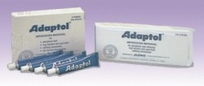
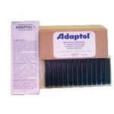
Impression waxes
Tilton describes use of very soft wax for the final border correction after making most of the impression with modeling compound.
Commonly used- ADAPTOL [Knap]
Distorts easily
Waterbath used has to be maintained at a constant temperature
Cant be used in undercut areas
Chilled wax is brittle- flaking.

Slide 12
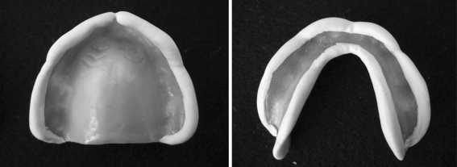
Elastomeric materials
Available in variety of colors,dors,viscosities,working and setting times.
Heavybodied form used for bordermolding
Used in cases with deep tissue undersuts
Difficult to trim the borders in case of excess
Polyether rubber material used by smith et all for simultaneous border molding. Trimmed with knife or bur and corrected with modelling compound.

Slide 13
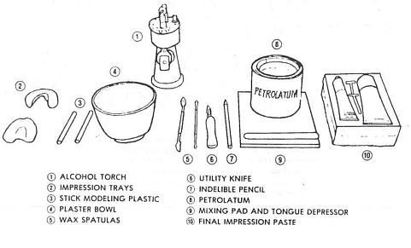
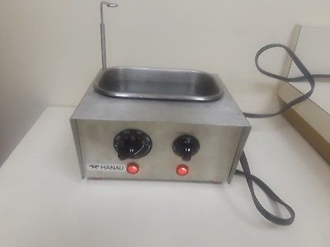
Armamentarium For Border Molding And Final Impression
WATER BATH
Tempering distributes the heat in the compound and the wet surface lessens the possibility of discomfort (140 ⁰)
B Levin. Impression for complete dentures, border-molding techniques. J Prosthet Dent. 1984;51:95–100

Slide 14
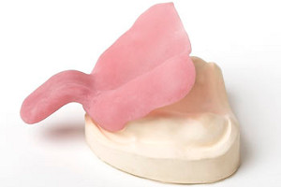
Procedure of border molding
38
Preparation of the custom tray
Check for the available space for denture flanges in the patient’s mouth
BUCCAL FLANGE LINGUAL FLANGE
Mark with pencil and reduce until they are short of reflection

Slide 15
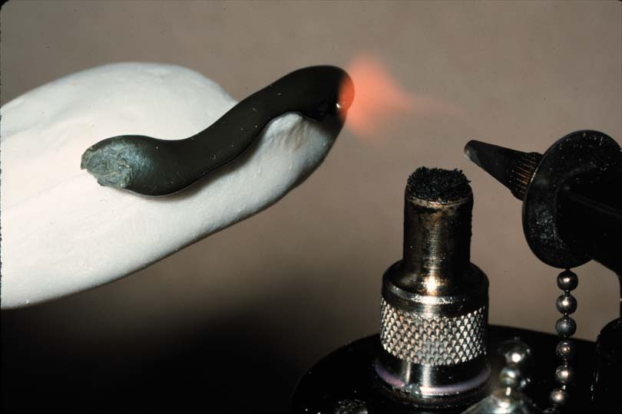
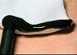
FIRST TECHNIQUE
Stick modeling compound is added in sections to the borders of the tray
HEATED
Done using a alcohol air torch
TEMPERED
MOLDED
Tray is now carefully removed from the mouth and the modelling compound border is chilled in ice water.
Notes:
Temp. color of sticksCompound is

Slide 16
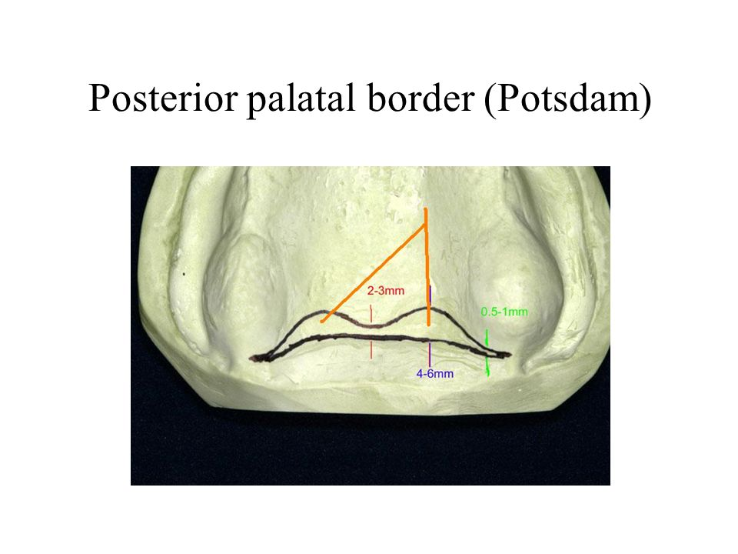
Why is it important to record the POSTERIOR PALATAL SEAL AREA???
Slightly displacing the soft tissues at the distal end of the denture to enhance the posterior border seal
Serving as a guide for positioning the tray properly for making the final impression.
Prevents excess material from running down the patients throat.

Slide 17
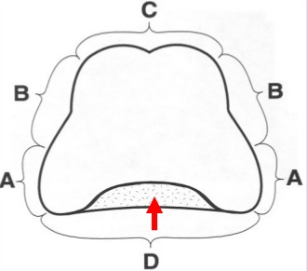
SEQUENCE OF BORDER MOLDING
PPS is added in the end & the tray is tested for the peripheral seal area
Picture Courtesey : Beumer J et al, UCLA

Slide 18
LINGUAL FLANGE | 4)Modelling compound on the distal edge is heated and PROTRUSION of tongue again performed – activation of the superior constrictor muscle 5) Patient asked to close while dentist applies downward pressure on tray – contraction of medial ptyergoid muscle Note : Patient should be able to wipe the upperlip vermillion border with tongue w/o displacement of the tray 6)Modelling compound placed on the posterior part of the retromolar fossa region and asked to open mouth wide – If tray is long then notch is formed in the posterior medial region of retromolar fossa.

Slide 19
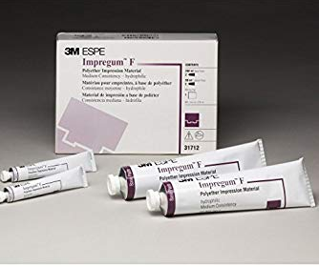
SECOND TECHNIQUE
Use polyether rubber base material called IMPREGNUM
ADVANTAGES OF THIS TECHNIQUE
No. of insertions reduced to two. Therefore, timesaving .
Development of all borders simultaneously avoids propagation of errors caused by a mistake in one section affecting the border contours in another

Slide 20
Requirements for this technique given by SMITH ET AL
Have sufficient body to allow it to remain in position on the borders during loading of the tray
Allow some preshaping of the form of the borders without adhering to the fingers
Have a setting time of 3-5 mins
Retain adequate flow while the tray is seated
Allow finger placement of the material into deficient parts after the tray is seated
Not cause excessive displacement of the tissues of the vestibule
Be readily trimmed and shaped so that the excess material can be carved and the borders shaped before the FI is made.
Notes:
McGivney has added that the material shoud be sufficiently rigid after setting and trimming so that FI material will not crack or craze.

Slide 21
PROCEDURE
Place adhesive for polyether impression on the borders of the tray . Cover 6mm inside the borders and 3mm outside the borders.
Express a 2 inch strip of polyether material from the large tube onto a large mixing pad. Next, express 2.5 inches of catalyst from the small tube.
Repeat same procedure for mandibular but take 4 inch strip of polyether and 3.5 inch catalyst.
Notes:
The reason for using less catalyst than recommended is to provide sufficient working time to complete the border molding of maxillary arch

Slide 22
Thoroughly mix the material for 30-45s using a metal spatula.
Position the polyether material on the borders,making certain a minimum with of 6 mm exists on the inner portion .
Quickly preshape the material to proper contours with fingers moistened in cold water.
Place the impression tray in the mouth as described in the 1st technique ,making certain to retract the lips sufficiently to avoid scraping the material from borders.

Slide 23
Inspect all borders to make certain that impression material is present in the vestibule. If there is deficient space, transfer some material from an adjacent site with a finger moistened in the patient’s saliva.
Border mold as described in the first technique.
Instruct the patient to elevate the tongue as tray is seated
Hold the lower lip out so that excess material flows labially
Have the patient drop the tongue

Slide 24
Quickly pull both the cheeks bucally to make sure that the buccal mucosa hasn’t been trapped.
Remove the tray when the impression material is set.
The material is set when no permanent indentation results when the fingernail is intruded into it. Examine the border molding and determine if its adequate. The contour of the borders should be rounded. Any deficient sites can be corrected with a small mix of polyether material or with a small addition of impression compound that will adhere to set polyether.
Overextensions are readly detected because the tray will protrude through the polyether border moulding

Slide 25
THIRD TECHNIQUE
Maxillary impressions made with impression compound and then converted into a tray .
OBJECTIVE- to obtain a record of approximate shape of the basal seat and have sufficient bulk in it so that the tray is made from it.

Slide 26
KNIFE TRIMMING – done with very sharp knife.
Objective- shape the prelimnary impression as nearly as possible into the shape of the denture to be constructed
Borders are carved so it is atleast 2 mm thick at the border - for adequate support
Border molding is performed after trimming the borders using the P.I
Space created by scraping the impression compound for Final Impression material to occupy
Final impression made

Slide 27
Separating The Compound :The compound impression is to be used as a final impression tray ,it is separated carefully.
Trimming The Compound Tray :
A pencil mark is applied in the inner border of the impression at a 45⁰ angle. The flanges height is reduced to approximately the height of the mucosal reflection
Anteriorly , the width is adjusted approximately 2mm . Posteriorly , it should fill the postmalar space.
Palatally , it should extend to cover the posterior vibrating line.

Slide 28
Attaching Handles :compound handles are attached to the tray for grasping and support.
Border molding the compound tray : Done in segments .
The right and left buccal flanges is flame softened with a blow torch to a depth of 2-3 mm .
Then anterior segment is flamed and molded .
The coronoid process is checked and cleared by asking the patient to move the mandible side to side.

Slide 29
Scraping The Compound : Compound impression is scrapped to make space for the final impression material
Entire surface is scraped to a depth of 1mm .
The relief areas are further reduced by 0.5 to1mm .
The border areas is reduced by about 1.5 mm

Slide 30
TEST FOR RETENTION
MAXILLARY
MANDIBULAR
Upward and outward pressure in the incisor region
Upward and outward pressure in the premolar region
Pulling the upper lip downward.
Protrude the tongue
Move the tongue in lateral direction
Roll the tongue back to touch the palate
Open mouth
Exerting vertical pull on handle
Forward pressure on distal aspect of handle.

Slide 31
conclusion
Accurate recording of the denture bearing area in complete denture is crucial for the preservation of the health of tissues and underlying bone, function, as well as proper retention of the dentures

Slide 32
References
Smith DE, Toolson LB, Bolender CL, Lord JL.One-step border molding of complete denture impressions using a polyether impression material. J Prosthet Dent. 1979 Mar;41(3):347-51.
A Olivieri, AG Zuccari, D Olivieri. A technique for border molding with light-polymerized resin. J Prosthet Dent. 2003;90:101–101.
B Levin. Impression for complete dentures, border-molding techniques. J Prosthet Dent. 1984;51:95–100

Slide 33
REFERENCES
EG Solomon. Single Stage Silicone Border Molded Closed Mouth Impression Technique - Part II. J Indian Prosthodont Soc. 2011;11(3):183–188.
GA Zarb, CL Bolender. Boucher’s prosthodontic treatment for edentulous patient, 11th ed. St. Louis:Mosby 1997: 141–Mosby 1997: 161.
Drago CJ.A retrospective comparison of two definitive impression techniques and their associated postinsertion adjustments in complete denture prosthodontics. J Prosthodont. 2003 Sep;12(3):192-

Slide 34
THANK YOU

