Slide 1
REMOVABLE APPLIANCES
DEPARTMENT OF ORTHODONTICS &
DENTOFACIAL ORTHOPEDIC
SCHOOL OF DENTAL SCIENCES
KIMS-DEEMED UNIVERSITY

Slide 2
LEARNING OBJECTIVE-
AT THE END OF THE CLASS THE STUDENT SHOULD BE ABLE TO-
The student should know what is removable appliances
They should know advantages, disadvantages & indication of removable appliances
They should know fabrication of removable appliances
They should know clinical significance

Slide 3
CONTENTS :
  DEFINITION
  ADVANTAGES
  LIMITATION
  INDICATION
  CLASSIFICATION
  COMPONENTS
    CLASPS

Slide 4
BOWS

Slide 5
LABIAL BOWS
Labial bow is an essential component of removable orthodontic appliances
It can be either active or passive
The principal function of the bow is to retrude the anterior teeth
It can be used for retentive purposes

Slide 6
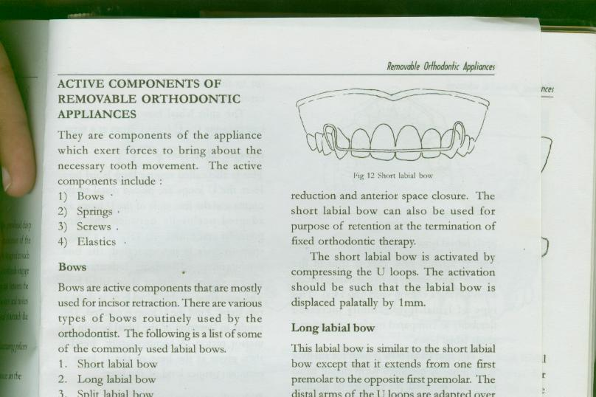
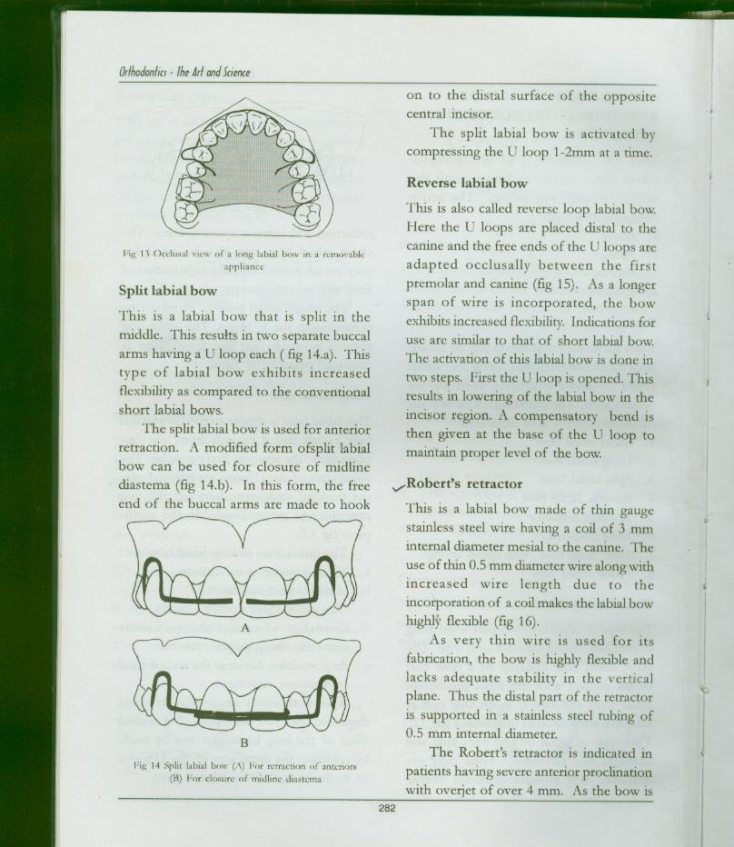
Parts of labial bow
The incisor segment
Vertical loops
The occlusal or cross over section
The retentive ends

Slide 7
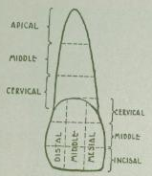
Placement of the incisor segment
Active bow
placed at the junction of incisal and middle third
0.6 or 0.7 mm SS Wire used

Slide 8
Retentive or passive bow
placed at the junction of cervical and middle third or below the height of contour
0.9 or 1 mm SS Wire used

Slide 9
Types
Short labial bow
Long labial bow
Roberts retractor
Reverse labial bow
Begg’s labial bow
Mills retractor
Fitted labial bow

Slide 10
Short labial bow
Indications
Retraction of anteriors
Anterior spacing with proclination
Overjet reduction
There should be good contact between canine and premolar

Slide 11
0.7mm wire used
Fabrication:- labial segment of wire is placed at the junction of the incisal and middle third.

Slide 12
Vertical segment starts from mesial third of canine, should be perpendicular to the incisor segment & should be away from gingiva
Occlusally, it passes between canine and premolar

Slide 13
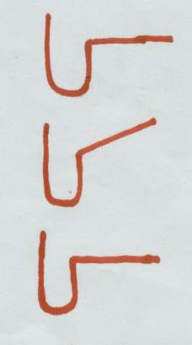
Retentive ends adapted on the lingual or palatal side.
Activation - Compressing the U-loop by 1mm

Slide 14
Long labial bow
Indications
Anterior space closure
Overjet reduction
Closure of the space distal to the canine
As a retaining device at the end of fixed therapy

Slide 15
0.7 mm wire used in active purpose
0.9 mm wire used in passive purpose
Fabrication - same as short labial bow but occlusal wire passes between two premolars
Activated by compressing the U-loop

Slide 16
Roberts retractor
It was first designed by G.H Robert
Indication
it is suitable only for retraction of four incisors following retraction of canines

Slide 17
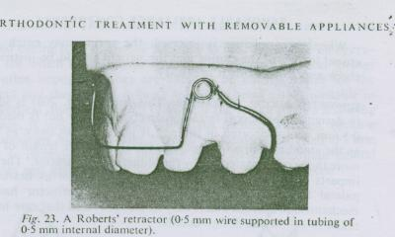
This is a flexible bow which is constructed from 0.5 or 0.6 mm wire inserted into a stainless steel tubing to give support to either end of the bow

Slide 18
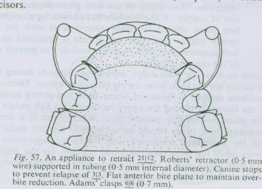
Fabrication
Labial segment of wire is placed at the junction of the incisal and middle third
Extends only two thirds of the mesiodistal width of the lateral incisors
A coil of 3mm internal diameter placed mesial to canine

Slide 19
It is activated by closing the coil

Slide 20
Reverse labial bow
Indication
For retaining tooth positions
For minor tooth movements

Slide 21
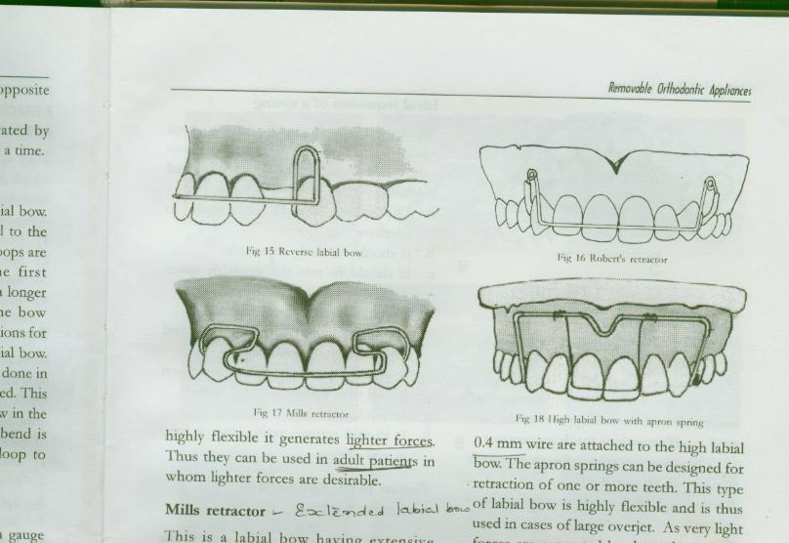
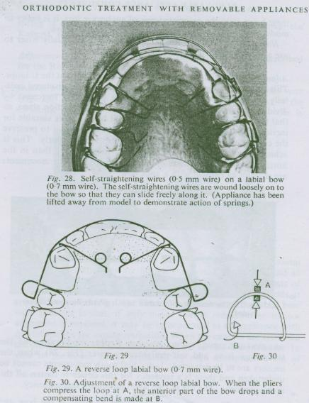
0.7 mm wire used
Fabrication:-loops are placed distal to the canine and the free ends of the U-loops are adapted occlusally between the premolar and canine

Slide 22
This is too stiff for effective incisor retraction
Activation
First the U-loop is opened this results in lowering of the labial bow in the incisor region .
A compensatory bend is given

Slide 23
Begg’s labial bow
(Wrap Around / Around the Globe Bow)
Popularized by P.R . Begg
It is used as retainer after fixed orthodontic therapy
0.9 mm wire is used

Slide 24
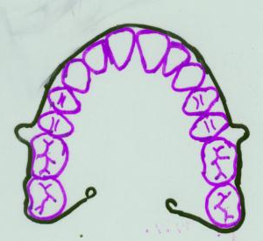
Fabrication
consists of labial wire that extends till the last erupted molar
U-loop is incorporated at the pre molar and molar area to close the band spaces

Slide 25
Mills retractor
It is also called extended labial bow
Indication
Large overjet
For alignment of irregular incisors

Slide 26
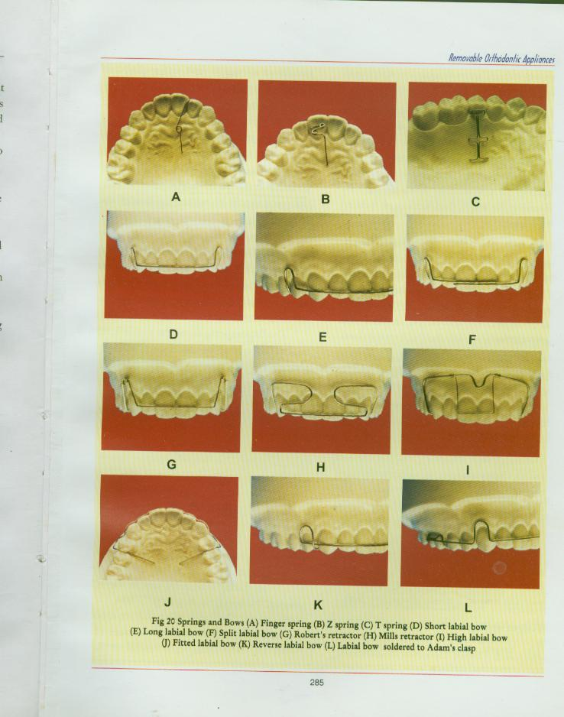
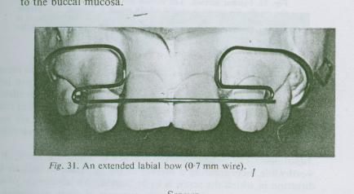
0.7 mm wire is used
This labial bow has an extensive looping of the wire so as to increase the flexibility and range of action
Poor patient acceptance
Complex design

Slide 27
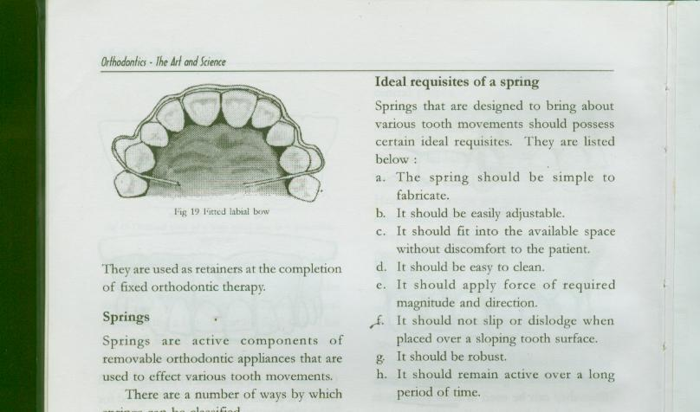
Fitted labial bow
Used to secure the incisors firmly after they been rotated
It acts as retainer
It is not used in active tooth movement
0.7 mm wire is used

Slide 28
High labial bow with apron spring
Used in retraction of one or more teeth
Large overjet
It is very similar to a Roberts retractor
Highly flexible
Light force

Slide 29
Fabrication
A heavy base arch of 0.9mm to 1mm wire extends into the buccal sulcus
apron spring made of 0.4mm wire is attached to the high labial bow

Slide 30
Activation
It is activated by bending the upright arms of the apron springs towards the teeth
3mm activation at a time
Disadvantages are difficulty in construction and soft tissue injury

Slide 31
Split labial bow
Used for anterior retraction
Closer of midline diastema

Slide 32
THANK YOU

